Slide 1


OPPORTUNITY REVIEW
SLUHN DTE
EXECUTIVE SUMMARY
Benefits of an SLUHN DTE Health Plan

Slide 2


Founded in 1979, headquartered in Indianapolis
Largest Independently-Owned Full-Service Third-Party Administrator
Specialize in Administration of Self-Funded Plans and Population Health Management​
Leader in the Direct-to-Employer Movement
We Know and Understand the Market
Experience Working with All Professional Teams: Agents, Networks, MGAs
The Key Family of Companies is a Vertically Integrated group of benefit related organizations
3,000+ Corporate Clients
3 Million Members under Management
700 Employees

Slide 3


MARKET LEADER
IN
PRIVATE LABELED
DTE PLANS
Louisville, KY
OneHealth Plan
Cincinnati, OH
TCH Optimal
Bentonville, AR
Northwest Health Plan
Knoxville, TN
East Tennessee Health Plan
Meridian, MS
Affinity Health Plan
Fort Myers, FL
Lee Health Care Partners
Track Record of Success
With Average Growth of 25+ Employers in First Two Years

Slide 4

Exclusive to KBA Plans:
Integrated Patient Credit Card and Bonus Benefits
KBA uses innovative supplemental bonus benefits and a no-interest patient credit card to:
Erase deductibles or sometimes even provide cash back when patients seek care at SLUHN facilities.
Dramatically improve self-pay rates for patients at SLUHN facilities.
Provide narrow-network steerage in a PPO plan, so that patients can go elsewhere but rarely will choose to.
SLUHN can offer these new, high-satisfaction benefits to employees as a coverage option
(best of all options plan—a broad PPO plan combined with vanishing deductibles for SLUHN care).
SLUHN patients will often receive cash, not bills after care episodes!
Notes:
Make necessary changes to match slide 4 of updated ppt provided by Jan

Slide 5

COMMUNITY BASED SALES STRATEGY
Locally based sales rep with strong community ties
Collaboration with DTE provider partners to identify strategic employers for early adoption and sales
Work with select broker distribution partners with aligned incentives and goals
Pipeline reporting and collaboration with our DTE provider partners
Marketing and promotion of the new option in the community
5

Slide 6

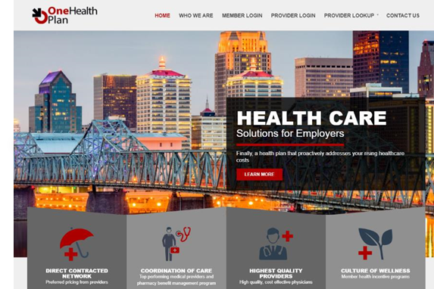
Complete Marketing System
Customized Branding and Messaging
Customized Brochures
Customized Web Site
Targeted Employer Outreach
Sales System (Social Media, Email, Text, etc.)
6

Slide 7

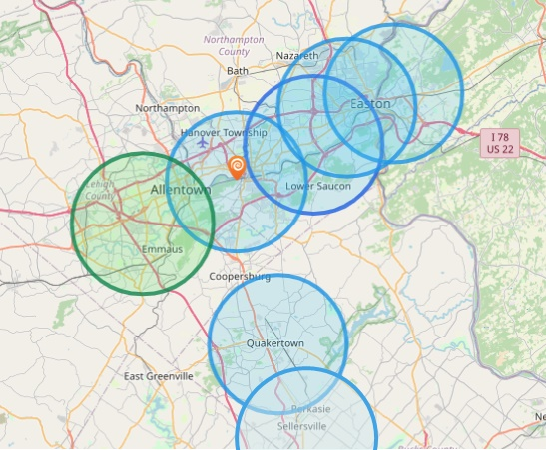

SLUHN ADVANTAGE: BEST-IN-AREA PATIENT ACCESS
Hospital | Population Within 5 Miles
St Luke's Hospital - Anderson Campus | 142,000
St Lukes Upper Bucks Campus | 46,000
St Luke's Hospital Bethlehem | 255,000
St Luke's Warren Hospital | 118,000
St Luke's Hospital - Easton Campus | 141,000
St. Luke’s Hospital Monroe County | 48,667
St. Luke’s Hospital Carbon County | 26,628
Grand View Hospital | 70,739
Hospital | Population Within 5 Miles
Lehigh Valley Hospital Cedar Crest | 227,393
7

Slide 8
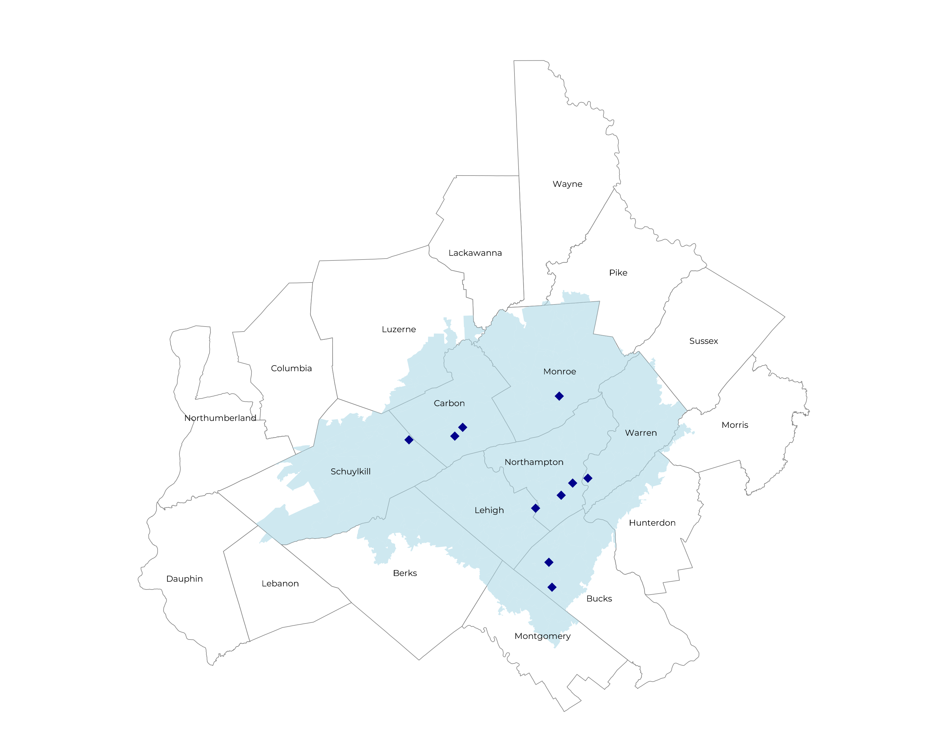
SIGNIFICANT OPPORTUNITY FOR PLAN GROWTH RESEARCHED FOR SLUHN SERVICE AREA
Target Market 1,500+ Employers 300,000+ Employees 600,000+ Members
 | Employer Size Group (# of Employees)
Commercial Employers With Headquarters | 50-100 | 101-200 | 201-400 | 401-1,000 | 1,001-3,000 | 3,000+
In Catchment Area | 956 | 385 | 236 | 119 | 31 | 21
Total Employees at Employers | 50-100 | 101-200 | 201-400 | 401-1,000 | 1,001-3,000 | 3,000+
Headquartered in Catchment Area | 71,700 | 57,800 | 70,800 | 83,300 | 62,000 | 126,000
Total Members with Employers | 50-100 | 101-200 | 201-400 | 401-1,000 | 1,001-3,000 | 3,000+
Headquartered in Catchment Area | 129,100 | 104,000 | 127,400 | 149,900 | 111,600 | 226,800
8

Slide 9
PROJECTED PLAN GROWTH
Year | Employees | Members | Percent of Members Choosing SLUHN for Inpatient Care | Percent of Members Choosing SLUHN for Outpatient Care
1 | 1,600 | 2,900 | 65% | 55%
2 | 3,100 | 5,600 | 65% | 55%
3 | 5,200 | 9,400 | 70% | 60%
4 | 7,800 | 14,000 | 71% | 63%
5 | 11,000 | 19,800 | 71% | 64%
6 | 15,100 | 27,200 | 72% | 64%
7 | 20,000 | 36,000 | 72% | 65%
8 | 25,700 | 46,300 | 72% | 65%
9 | 32,200 | 58,000 | 72% | 66%
10 | 39,100 | 70,400 | 72% | 66%
11 | 46,300 | 83,300 | 73% | 67%
12 | 53,300 | 95,900 | 73% | 67%
13 | 59,800 | 107,600 | 73% | 68%
14 | 65,600 | 118,100 | 73% | 68%
15 | 70,600 | 127,100 | 74% | 69%
16 | 74,600 | 134,300 | 74% | 69%
17 | 77,900 | 140,200 | 74% | 69%
18 | 80,300 | 144,500 | 74% | 70%
19 | 82,200 | 148,000 | 74% | 70%
20 | 83,600 | 150,500 | 74% | 70%
KBA currently estimates that Saint Luke's University Health Network has 39% inpatient market share, and 24% outpatient market compared to hospitals/clinics within eight (8) miles of the SLUHN service area.
KBA very conservatively projects this steerage to allow for other partners to be included in the tier 1 level if SLUHN decides.
9

Slide 10
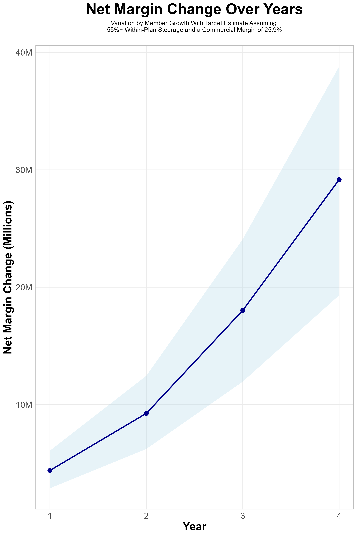
Direct Costs and Anticipated ROI Through 2029
Target Member Growth |  | Target Member Growth | Target Member Growth | Target Member Growth | Target Member Growth
Metric | 2025 | 2026 | 2027 | 2028 | 2029
Number of Members | 0 | 2,800 | 5,600 | 9,300 | 14,000
Incremental Margin | 0 | 4,687.4K | 9,369.0K | 18,093.8K | 29,178.1K
Network Access Fee ($1 PMPM) | 0 | 33.6K | 67.2K | 111.6K | 168.0K
Implementation Fee (One-Time) | -150.0K | 0 | 0 | 0 | 0
Sales and Marketing Costs | -180.0K | -180.0K | -180.0K | -180.0K | -180.0K
Net Margin Change | -330K | 4,541.0K | 9,256.2K | 18,025.4K | 29,166.1K
Direct Costs to SLUHN:
Set-up fee of 150K (first year only)
Sales and marketing fee of 180K (yearly)
10

Slide 11
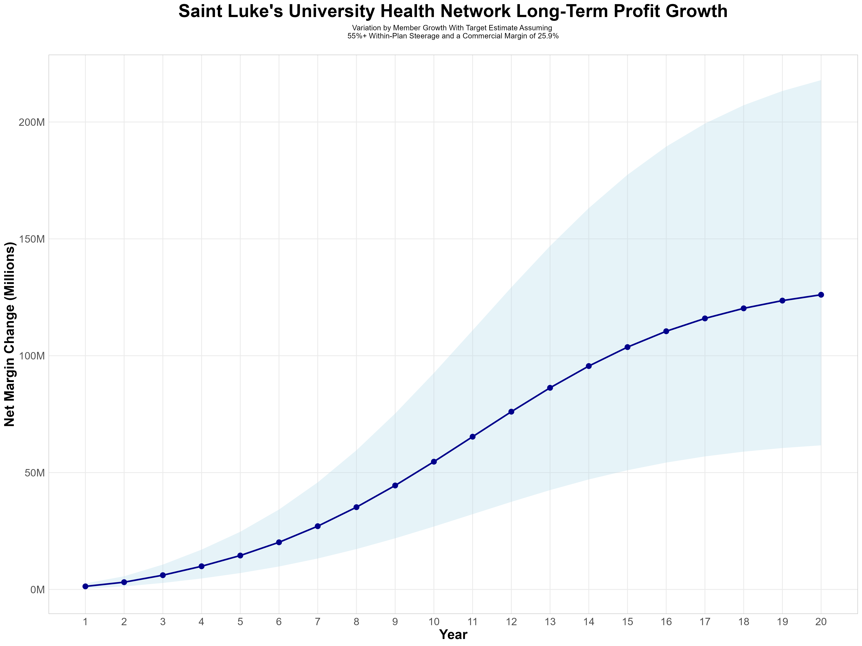
GROWING POWERFUL, LASTING PROFITABILITY
Early Stage
Gaining Name Recognition, Early Growth
New Revenue:
New Profit:
$35.58M
$9.19M
Growth Stage
Strong Reputation, Strong Growth
New Revenue:
New Profit:
$211.65M
$55.59M
Mature Stage
High Profitability, Market Saturation
New Revenue:
New Profit:
$432.48M
$113.67M
11

